Slide 1
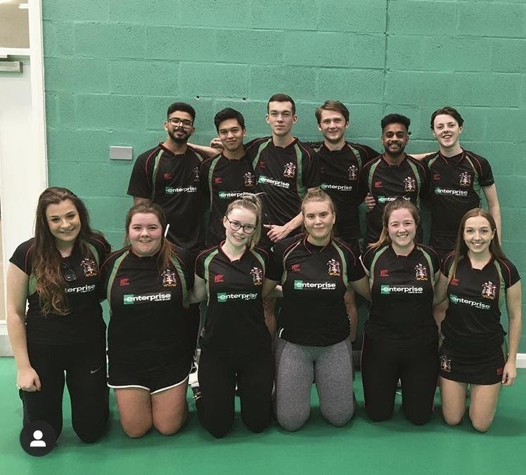
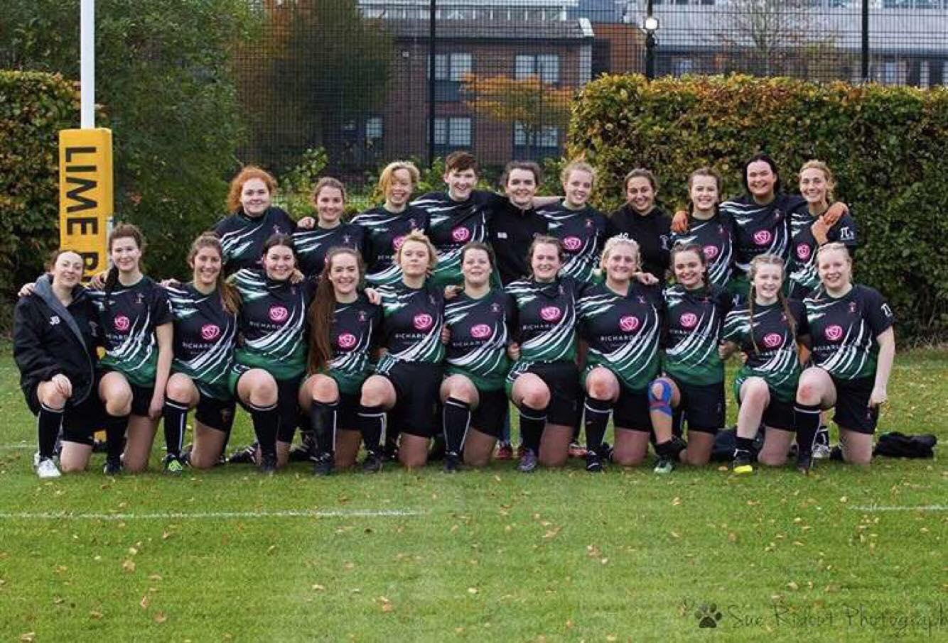
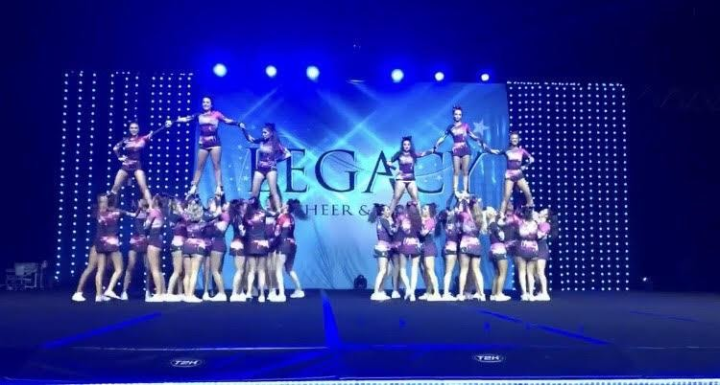
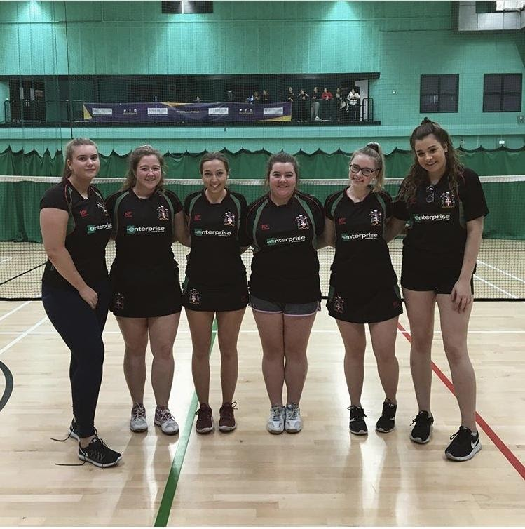
WELCOME TO LIVERPOOL HOPE STUDENTS UNION
2020

Slide 2
Introduction
Welcome from the President Harry Pearce
Email: Pres@hope.ac.uk
Liverpool Hope Students’ Union is, quite simply, every student at Hope coming together to make positive change.
Your Elected Officers work toward this by representing your views, needs and concerns to the University and relevant
external organisations. We’re here to offer advice on a variety of things from academic matters to housing,
as well as giving you the opportunities to do what you love doing through our clubs, societies and sport teams.
Here at LHSU We are part of a rich and proud history deeply caring about creating a sense of belonging and caring for
students. As of the day you enrolled here at Liverpool Hope University, you became a part of our SU.
My aim is to ensure our members have the skills and capabilities they need to fulfil their potential; that they have
memorable experiences and seize opportunities whilst at Liverpool Hope and that they are able to take advantage
of opportunities which will enhance their employability.
I look forward to the year ahead and working with all of our students. Remember the Students Union is here for you,
please get in touch with us if you require anything.

Slide 3
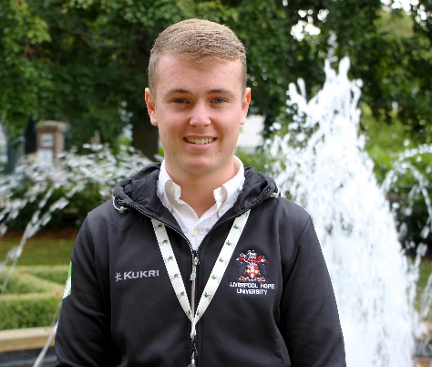
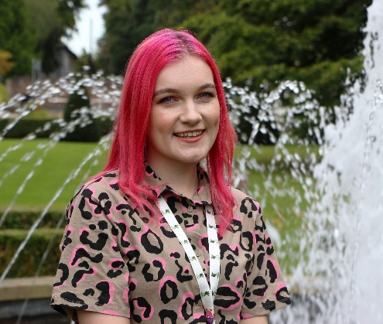
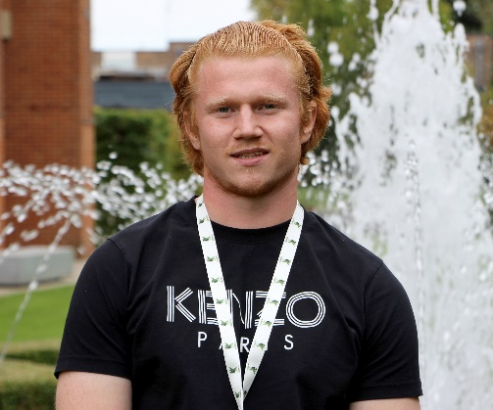
Your Student Officer 2020/21 are:
President – Harry Pearce
Vice President Welfare and Community – Sally Wills
Vice President Sports and Activities – Ollie Smith

Slide 4
Campaigns this year
Harry (President)
Top five manifesto points:
Working on a more inclusive education for all. Continuing the work, the union has already done on this.
Creating more opportunities for commuting, exchange and mature students.
Expanding the role of some course reps to take on welfare/ buddying responsibilities in particular with people from different levels of study.
Working on ensuring that all students get enough opportunities to develop personal skills while at university. Skills such as leadership, resilience, organisation etc.
Show support and encourage the SU to get involved with competitions ran within the university such as the business departments young enterprise competition.

Slide 5
Sally - Vice President Welfare & Community
Hi I'm Sally, your Vice President Welfare and Community 20/21. My role puts me at the forefront of your well-being concerns & to bridge the gap between Hope and the local community. During my three years of study as a (BA) Fine Art student, I found that my practise often focused on raising awareness and challenging social issues. Naturally, this led to a hands on role, campaigning for change locally with a particular focus on environmental concerns. My officer role allows me to continue and apply my passion to improving student experience here at Hope. My particular aims are to build partnerships with local charities, which will provide students with personal development opportunities via volunteering and educational workshops. Giving students the chance to make a difference in areas that most concern them, which will have a wider community impact. As well as collaborating with mental health focused charities, I want to increase in house support. Making students fully aware of what their options are from the university's mental health services, particularly to those from marginalized groups who may face isolation. Creating peer support systems will hopefully create a vigilance and stop students falling through the net. I believe mental health focus is vital this year and as a result I will undergo my own training opportunities to be more knowledgeable and aware of such issues. I will be utilizing my previous experience in climate action to address the university's environmental footprint. Making small sustainable differences day to day but ultimately reflecting on the University's impact at an institutional level. Most importantly the SU is your forum for your concerns. Please don't hesitate to get in touch with us and we are happy to work alongside you in making the change you want to see.
If you have any welfare queries please e mail vpreswelfare@hope.ac.uk in the first instance. You can also reach me via Instagram @vpreswelfare and via the phone on 0151 291 365

Slide 6
Ollie (Vice President Sports & Activities)
Hi Guys, I am Ollie Smith, your elected Vice President of Sport & Activities for 2020-2021.
I would like to heavily focus on improving the student engagement around all campuses. I aim to achieve this through both academic and practical means, ideally students will have the opportunity to learn new skills in the class and implement these to benefit both themselves and the sport teams and societies around us.
I have studied at this university for the previous 4 years from undergraduate through to post-grad, I feel this leaves me open to hear from anyone and everyone, whatever you may be experiencing or concerned about, I likely went through the same too!
We have a vast array of clubs and societies here at Hope (check out the page for more info on all of them!). I was very privileged in helping run a team myself for the past few years, I hope to re-create some of the hard working and positive ethos I installed there.
I look forward to the future, as should you.
@Ollie Smith @vpsportnactivites (Instagram), Ollie Smith (VP Sport) - Facebook
E-mail - vpressanda@hope.ac.uk

Slide 7
Why Should you join a Club or Society?

Slide 8
Sports Clubs
We currently have 14 active Sports Clubs at LHSU. All of our clubs play on a regular basis, mostly in the British University and Colleges Sports’ leagues. There are no lessons on Wednesday afternoons to give you the opportunity to get stuck in to sport!
You can join any sports club by paying the £30 annual membership fee at www.hopesu.com For just £30 you will receive:
Guaranteed two hours training facilities provided
Personal Accident Insurance in case of injury whilst playing
Free travel to matches.
In recent years, Hope SU have been very successful. Last Year our men's Rugby and Women's Hockey won their league. The year prior to this our Gaelic were the all Ireland champions. Our Women's Netball, Men's football, and Basketball all won their leagues.
Every Spring, we hold a Sports Awards even to celebrate the achievements of our teams and would love to see you there.
The sports teams we currently have are:
Netball Men's Rugby Women's Rugby Women's Football Men's Football
Women GAA Men's GAA Basketball Women's Hockey Cricket
Badminton Lacrosse Futsal
If there is a sports team which you like but we don’t have you can always start up a new club all you need is 7 other people that are interested and we can do the rest.

Slide 9
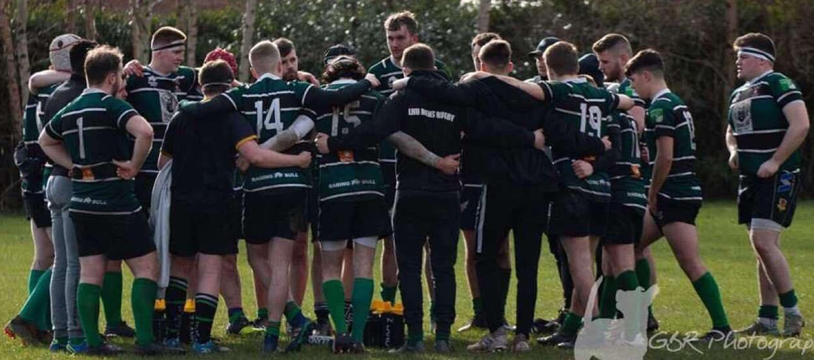
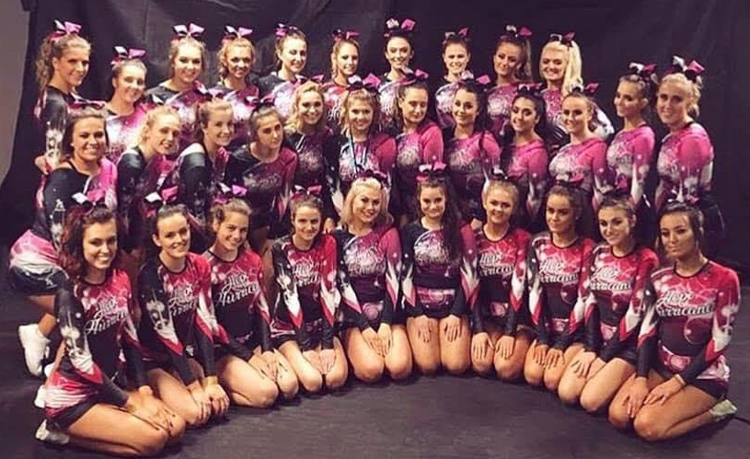

Slide 10
Societies
We have a whole host of different societies here for you to join. Whether you’re looking for an Academic Society or just a group of people who like the same things you do, were sure to have something you’re interested in – just have a look at list below!
And if we don’t? Start a society of your own! You just need 7 other students who are interested and we’ll take it from there.
We currently have:
Hiking Society Disability Studies Society Christian Union Dance
British Sign Language Musical Theatre International Students Power lifting
Extinction Rebellion Good Game Nerd Society Catholic Society Cheerleading
Students for social change Labour Students Irish Society Table Tennis
Conservative Students Samba Society Afro Caribbean Rounders Society
Feminism Society Poker Society Harry Potter Baking
Snow Society Politics Society LGBT+ Society Drama
Islamic Society (ISOC)

Slide 11
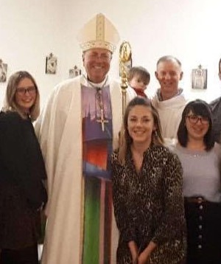
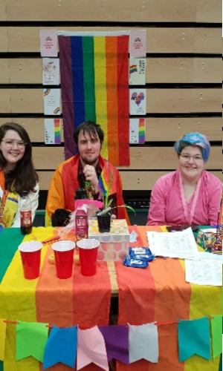
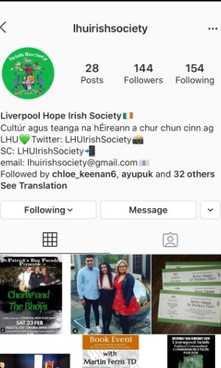
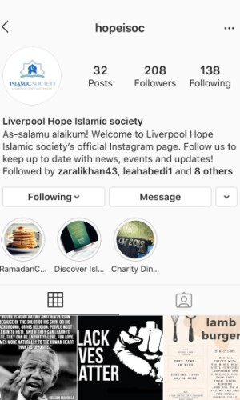

Slide 12
Campaigns
We are here to campaign for a better student experience. We lobby the university as well as local and national politicians to ensure that student views and interest are as the heart of all their decisions. Key activities in the past have included:
Lobbying the University to change dissertation deadlines
Running a ‘This Girl Can’ campaign in partnership with the university to encourage more women to get involved in sport
Lobbying stagecoach to make the 86c 24hrs
Lobbying the University to open the our place bar earlier for Wednesday games
Lobbying purpose built student accommodation during covid to ensure students are treated fairly
Lobbying the University to remove the last term rent.
The issues we take up are determined by you as members. If you feel there is a pressing issue that we should campaign on, get in touch with us on union@hope.ac.uk or pop into the office in the LTC building.

Slide 13
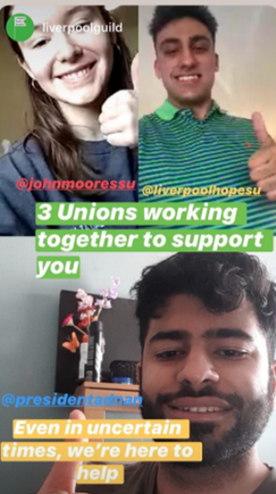

Slide 14
Student voice
Our aim is provide students with a strong voice, the Student’s Union has three elected official; President Harry Pearce, Vice President Welfare and Community Sally Wills and Vice President Sports and Activities Ollie Smith. Our jobs are to improve student experience on wellbeing and academia and ensure the views of students are articulated at every opportunity.
Course Reps
Every course has Course Reps, elected students who are passionate about representing the views of students on academic issues at Staff/Student Liaison Committee meetings, Issues that are raised by Course Reps are taken up by your President to resolve and we also organise training and support for course reps throughout the year.
Want to become a Course Rep?
If you would like to be the Course Rep for your course, you will need to speak to your lecturer/tutor and ask for advice as to who you should contact with regards to becoming a Course Rep and/or if you have one already, as it is the University who is in charge of the actual Course Rep elections.

Slide 15
Forums
Our forums are a fantastic way to get involved in running your Student’ Union. They are open to all student to attend and are held 4 times a year, 2 in the first term, then one each in Spring and Summer terms. We’re looking for you to come along and have your say, giving us your ideas and policies to help improve your Student’s Union!
Big Ideas
No matter how big or small, we want to hear your thought on how to improve life at Hope University. Head over to the ‘Big Idea’ section of our website to let us know your ‘Big Ideas’ – you can even start a petition!
NUS Conferences
We send delegates to decide national policy at various NUS conferences. Any Hope student could represent the Students Union at these conferences. If you want to be a delegate to any NUS conference, keep any eye out for our emails or drop us a line a union@hope.ac.uk

Slide 16
Lead your Student Union
We are student led organisation, which means we’re run by students, for students, through the three main roles:
Student trustee
Part time Officer
Student Officer
Student trustees
LHSU is a charity and we are run by a Trustee Board, who have overall legal responsibility for the Students’ Union. If you think you have what it takes to be a trustee contact pres@hope.ac.uk
Part Time Officers
Every year, we recruit volunteer Part Time Officers to represents our various student communities. This is an excellent way to get involved with the SU and to shape Students Union policy. Some of the part time officers serve on the SU’s Executive committee which help run the Union between forums. We’ll be electing a new group of PTO in October so keep an eye out.
Student Officer
Your Student Officers lead the Students’ Union, representing your interests to Senior Management and staff across the University. Officers are elected every March and begin work in July and have either finished their course or want to take a year out of study to run the Students’ Union.
Being an Officer is an excellent way of proving to future employers that you have great leadership skills and are not frightened of making difficult decisions.

Slide 17
Nominations end 21st October Elections 26th 9/00am -29th October 9.00 pm

Slide 18
Advice Service
We have a dedicated Advice Service to offer you free, independent and confidential advice about any issue you may have. If you are having problems with your course or any other issue, please come and see us, we are here to help you!
We can provide advice and guidance on issues such as:
Academic & University related
Academic appeal Complaints about teaching provision and facilities
Extenuating circumstances Accommodation issues
Welfare issues Problems with research supervision
Disciplinary matters Discrimination
Academic misconduct Bullying and harassment
including plagiarism
Fitness to Practice Complaining to the Office of the Independent Adjudicator
Problems with placements Procedural irregularities
Unfair practices
Housing
Employment Law
Disability/ Mental Health ( inc issues with LSP)
Money/Debt issues
Welfare Rights
You can now book appointments in the advice via Facebook @Liverpoolhopesu alternatively you can email suadvice@hope.ac.uk or just pop into the office.
We also have drop ins on a Monday with the LSH advisor who an advise all matters housing.

Slide 19
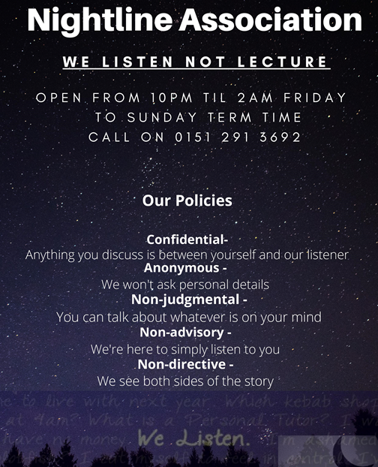
Nightline
Alternatively outide of the 9 to 5 hours we have a nightline service which runs Friday through to Sunday between 10PM and 2am.
Nightline is a confidential listening and information service FOR students BY students.

Slide 20
Contact us
Come and visit us in the Lecture Theatre Complex at Hope Park or in the Student’s Union space at Creative campus.
www.hopesu.com
E:union@hope.ac.uk
T:0151 291 3707
Twitter @Liverpoolhopesu
Facebook @Liverpoolhopesu
Instagram @Liverpoolhopesu

